Slide 1
OG Refactoring (observing gamma)

Slide 2
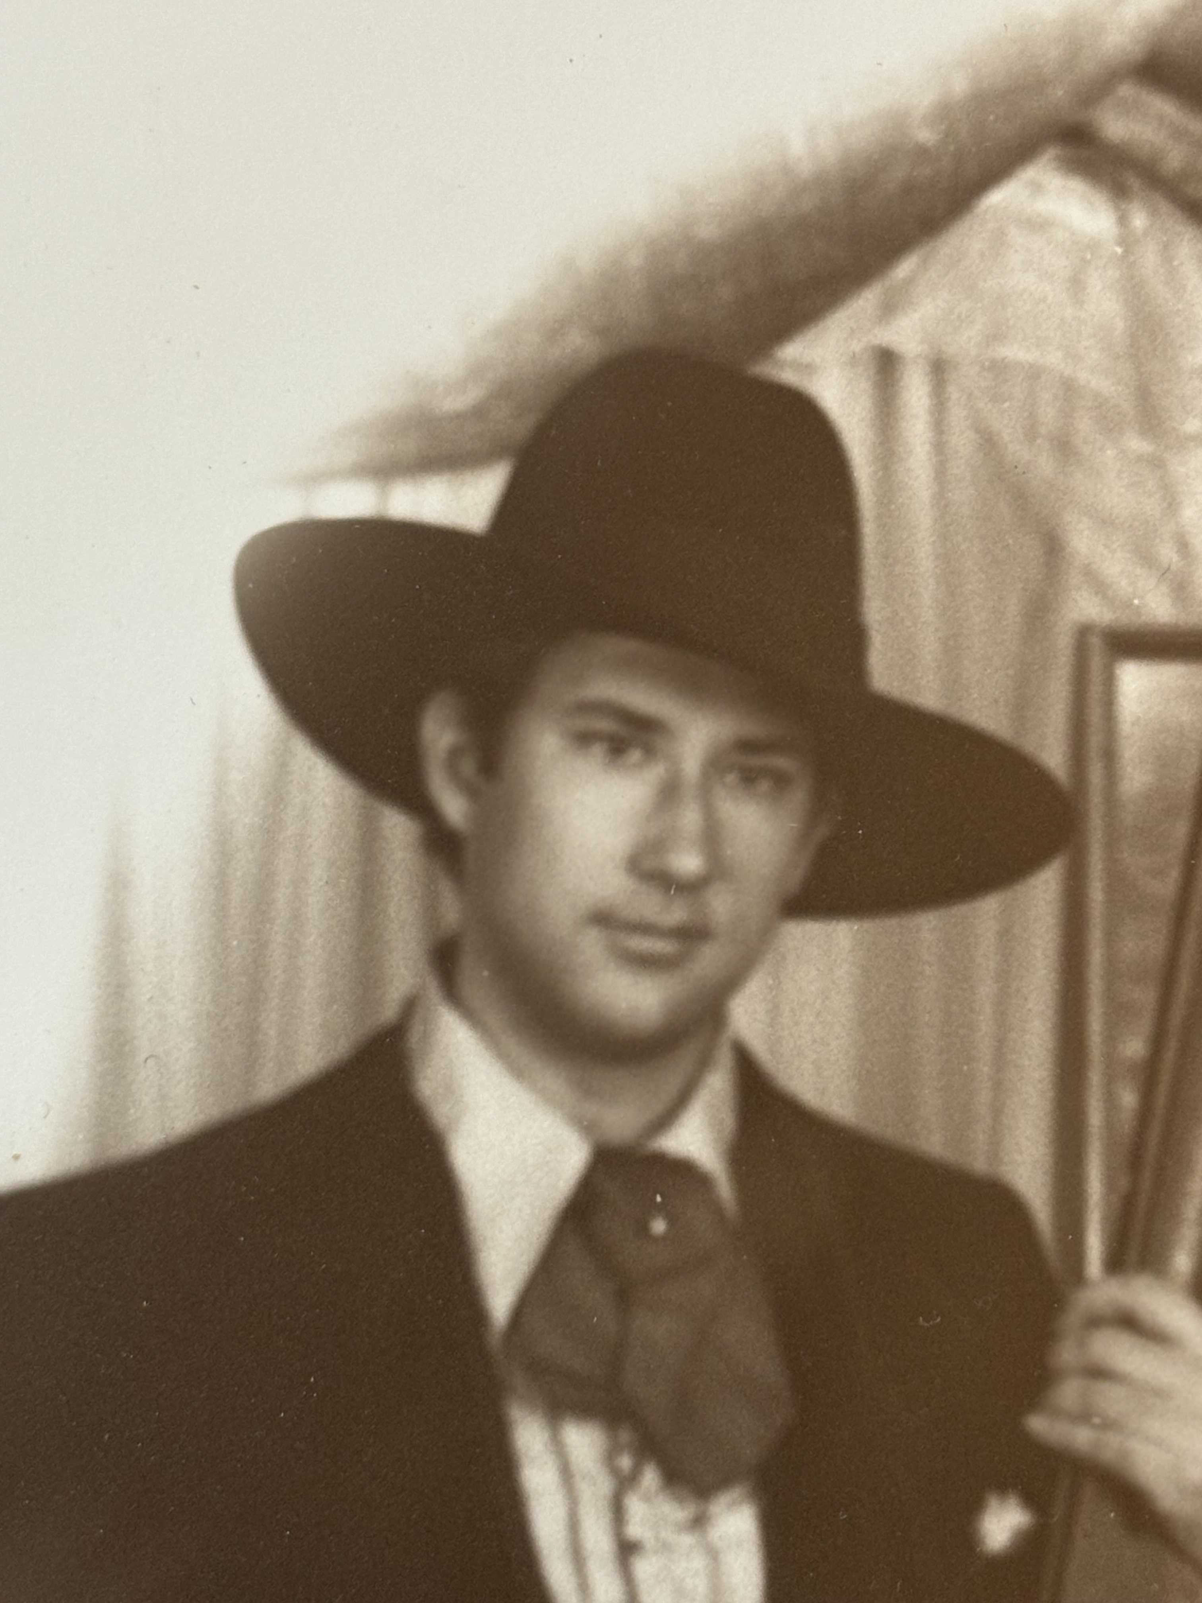
Aaron McClennen
I have watched multiple codebases become legacy.
My first read of Fowler turned my life around.
Started writing code in 1990
Notes:
How many have read refactoring?

Slide 3
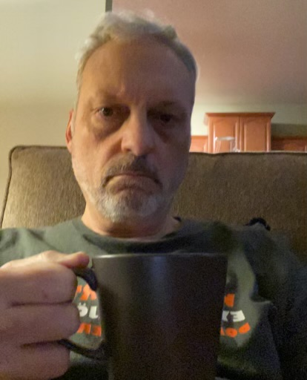
M. Jeff Wilson
SAFe 6.0 SPCT
Old school gamer
Coding since 1981

Slide 4
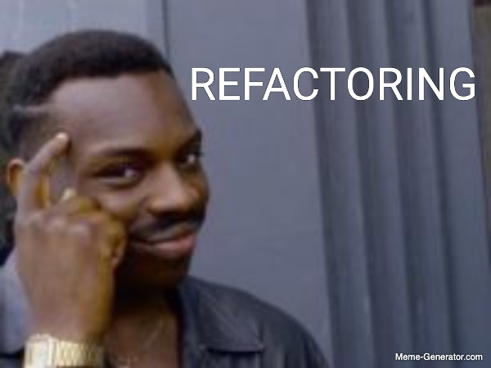
Goals
Rekindle Refactoring Excitement
Techniques for deciding what to refactor to
Notes:
? Audience engagement.
Who refactors
Who does large refactors

Slide 5
An example before starting to bore you

Slide 6
Some code with patterns
public abstract class ConnectionSrc {
private static ConnectionSrc src; // Off screen
public static Connection getConnection() {
return src.getTheConnection();
}
protected abstract Connection getTheConnection();
}
class RedisSource extends ConnectionSrc {
@Override
protected Connection getTheConnection() {
return new RedisConnection();
}
}
class OracleSource extends ConnectionSrc {
@Override
protected Connection getTheConnection() {
return new OracleConnection();
}
}
public interface Connection {
public String getProperty();
}
public class RedisConnection implements Connection {
@Override
public String getProperty() {
return "a value pulled from redis";
}
}
public class OracleConnection implements Connection {
@Override
public String getProperty() {
return "a value pulled from oracle";
}
}
Notes:
What patterns can you see here?
! Factory and Adapter.

Slide 7
Some code with patterns named
public abstract class ConnectionFactory {
private static ConnectionFactory src;
public static Connection getConnection() {
return src.getTheConnection();
}
protected abstract Connection getTheConnection();
}
class RedisFactory extends ConnectionFactory {
@Override
protected Connection getTheConnection() {
return new RedisConnection();
}
}
class OracleFactory extends ConnectionFactory {
@Override
protected Connection getTheConnection() {
return new OracleConnection();
}
}
public interface Connection {
public String getProperty();
}
public class RedisAdapter implements Connection {
@Override
public String getProperty() {
return "a value pulled from redis";
}
}
public class OracleAdapter implements Connection {
@Override
public String getProperty() {
return "a value pulled from oracle";
}
}
Notes:
Here are the two patterns named on the classes
! Factory and Adapter.

Slide 8
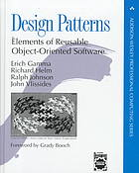
Gamma et al
First published in 1994
Occasionally overused
Still relevant today.
Notes:
Who knows of Gamma et all’s design patterns book? Who has actually read it?

Slide 9

Continuing Education
Doctors, Lawyers, Dentists, Social Workers all do continuing ed for licensure.
As software engineers we don’t get licenses, but we should study the advances and roots of our field.

Slide 10

Continuing Education
Welcome to Dev nexus
Doctors, Lawyers, Dentists, Social Workers all do continuing ed for licensure.
As software engineers we don’t get licenses, but we should study the advances and roots of our field.
See me after the talk to sign off on your CEUs
Notes:
And now back to refactoring

Slide 11
What is refactoring?
A disciplined technique for restructuring an existing body of code, altering its internal structure without changing its external behavior.
“Any fool can write code that a computer can understand. Good programmers write code that humans can understand.”
— Martin Fowler
Refactoring lowers the cost of enhancements.
Refactoring is a part of day-to-day programming.
Automation is helpful but not essential.

Slide 12
Why do we refactor?
To make it better
Easier to change
Easier to understand

Slide 13
Refactor towards patterns
If it Stinks, Change it
- Grandma Beck
When using patterns, naming the code using the pattern names makes it more quickly recognized.
Josh Kerievsky wrote a whole book on this topic.
Notes:
What patterns do you use?
Pattern refactors are useful for bigger changes.
Which brings me to how to do refactorings that aren’t already documented.

Slide 14
Standing on the shoulders of giants
Fowler and Kerievsky both talk about large refactorings, but don’t cover the details because they are too large.
Gamma et al. (Gang of Four) “Design Patterns: Elements of Reusable Object-Oriented Software” 1994
Fowler “Refactoring Improving the Design of Existing Code” 1999, 2018
Kerievsky “Refactoring To Patterns” 2005
Feathers “Working Effectively with Legacy Code” 2005
Notes:
The GoF patterns are a good targets to move code towards. See Kerievsky
Start with a foundation
Feathers gives help on what to do with code without tests.
He defines legacy code as code without tests.

Slide 15
5 Step plan
For dealing with large refactorings
Notes:
And one the shoulders of one dwarf
I introduced this plan last here at this very conference.

Slide 16
A plan to make a plan
Think of refactoring as a trip
Decide the Trip is Necessary
Understand the Landscape
Select a Destination
Chart Your Course
Make It So
Notes:
Last year I spoke mostly about step 4, where I discussed the steps for a large refactoring.

Slide 17
A plan to make a plan
Think of refactoring as a trip
Decide the Trip is Necessary
Understand the Landscape
Select a Destination
Chart Your Course
Make It So
Notes:
This talk will focus on steps 2 and 3 of refactoring planning.

Slide 18

Reading spaghetti
How do we make sense of what we have?
Notes:
By reading of course.

Slide 19
Reading spaghetti
How do we make sense of what we have?
Scratch refactoring
Diagram the code
Write a narrative
Add unit tests
Notes:
These are four structured techniques.

Slide 20
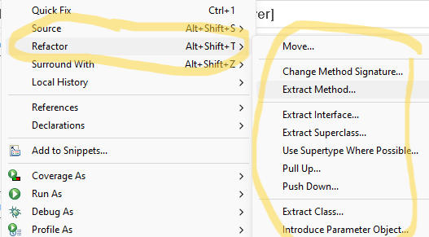
Scratch refactoring
From M. Feathers “Working effectively with Legacy Code”
Use refactorings to explore the structure and nature of the current code base.
Throw away the work (not the knowledge) when done.
Can be done without tests. Because it will be thrown away.
Automated refactorings make this go quickly.

Slide 21
Diagram the code
Draw Circles and Arrows to get a sense of what the parts of the system are.
This is Also in Feathers as “sketches”
Or Agile Modeling
Call Processor Register
Call Details
Agent Register
Notes:
Two threads accessing a shared object
AKA Agile modelling. Keep for just as long as necessary

Slide 22

Write a narrative
I like this one for complex methods to get a sense of the existing logic.
Putting the logic in your own words helps you internalize it.

Slide 23
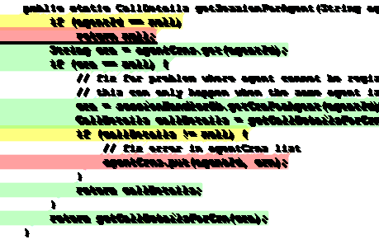
Add unit tests
When code has no tests, Feathers suggest writing “Characterization Tests”.
By changing the inputs to get full coverage you will understand what the class or method is doing.
Characterization Tests capture what the code does currently
Use a coverage tool to see what branches are tested.
After the initial run fails, set the expected result to the behavior of the current code.
Write additional tests to get fullish coverage.
Notes:
Or if you have existing unit test you can read those as well.

Slide 24
we know what the code does
Three techniques to understand the code
Scratch refactoring
Diagram the code
Write a narrative
Add unit tests
Now what
Notes:
On to the second half of the talk

Slide 25
Pattern Spotting
Notes:
Spot the pattern in the pile of spaghetti.
An example follows.

Slide 26
System Overview
Audio Stream
To Agent Headset
Call Processor
Call Processor
Orchestrator
Agent App 1
Agent App 1
Agent App 2
Agent App 2
Notes:
We are responsible for the orchestrator system

Slide 27
System description
Orchestrator is multithreaded web app.
The Call Processor intercepts and adjusts the audio stream that goes to the Agent
The Orchestrator tells the Call Processor what to do with the audio stream
Audio Stream
Orchestrator
Call Processor
Notes:
Break up this slide with the diagram on the page and highlighted.

Slide 28
System description
The Agent Applications tell the orchestrator who the agent is and what they can do.
Data flows asynchronously between the systems in both directions.
App 2 has a websocket for real time updates
Orchestrator
Agent App 1
Agent App 2
Notes:
Break up this slide with the diagram on the page and highlighted.

Slide 29
System description
Multiple instances of the call processor can be on the call.
Multiple agents can be on the call at once.
Call Processors and Agent Apps can connect and disconnect at will
Orchestrator
Agent App 1
Call Processor
Agent App 1
Call Processor
Agent App 1
Call Processor
Agent App 2
Agent App 2
Agent App 2
Notes:
Break up this slide with the diagram on the page and highlighted.

Slide 30
Call Processor actions
Redact
5 Call Processor Flags
Tokens
Redact a set of values from the call.
Send tokens to orchestrator.
Send a transcript of the call to a location.
Send an audio stream of the call to a second location.
Record the call.
Do nothing. (All flags false)
Transcribe
Stream
Record
Notes:
The orchestrator is responsible for directing the call processor
Keep the diagram present

Slide 31
5 Criteria for actions
Number of customer service agents on the call
Agent location: Office/Work from Home
Agent language: English/Spanish
Agent group: Each group has different responsibilities and restrictions
Which agent applications are connected to the call
Orchestrator
Agent App 1
Agent App 2
Notes:
5 X 5 = 25 possible combinations keeping track

Slide 32
Build the flags for call processor
public static enum Trigger {AGENT_REG, AGENT_UNREG, STOP_TRANSCRIBE };
public CallProcessorFlags compute(Call c, Trigger t) {
CallProcessorFlags flags = makeDefaultFlags(c);
switch (t) {
case AGENT_REG:
setRegistrationFlags(c, flags);
break;
case AGENT_UNREG:
setDisconnectFlags(c, flags);
break;
case STOP_TRANSCRIBE:
setTranscribeEndFlags(c, flags);
break;
}
return flags;
}

Slide 33
On Agent Registration
private void setRegistrationFlags(Call c, CallProcessorFlags flags) {
boolean maskSpiAudioFlag;
boolean procAgentWah = c.isProcessingAgentWah();
boolean multipleAgents = c.hasMultipleAgents();
flags.setListen(true);
if (procAgentWah || multipleAgents ) {
if (c.isSpanish() && ! spanishNotSupported(c.getAgentGroup())) {
maskSpiAudioFlag = false;
} else {
AgentSession currentAgentSession = c.getAgentSessionByAgentId(c.getProcessingAgentId());
if (! multipleAgents && ! currentAgentSession.haveWebSocket() && ! procAgentWah) {
maskSpiAudioFlag = false;
} else if (c.hasMultipleAgents()){
maskSpiAudioFlag = true;
} else {
maskSpiAudioFlag = false;
}
}
} else {
maskSpiAudioFlag = c.hasWahAgent() ;
}
…
if (maskSpiAudioFlag) {
flags.setRedactionEntities(c.getMaskedItems());
}
if (c.dontTranscribe()) {
flags.setTranscriptTarget("");
} else {
flags.setTranscriptTarget(c.getTranscribeTarget());
}
}
Notes:
This is simplified from actual wild code.
What pattern could improve this code?

Slide 34
It’s a State Machine
No Agent
No Call
Connected
Transcription
Only
Redaction Agents
Register and Agent Unregister will transition between these three states
Agent Only
Center Agent
WAH Agent
Mixed Agents
Collecting
Notes:
Partial credit if you said strategy.

Slide 35
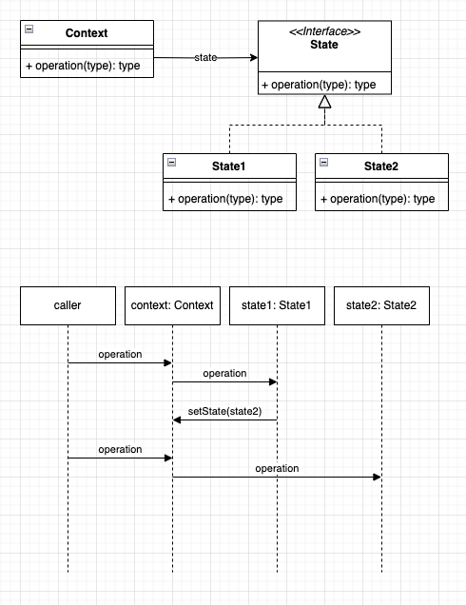
Official state Pattern
The State pattern allows an object to change its behavior at runtime based on its internal state.
May be cleaner than using conditional statements.
State-specific behavior should be defined independently: adding new states should not affect the behavior of existing states.

Slide 36
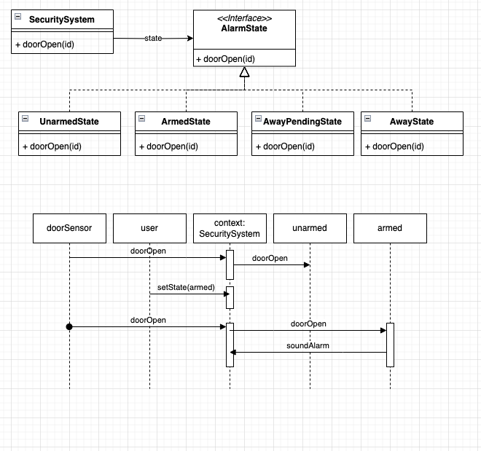
State Pattern Example
Household security system is a state machine:
State: Unarmed. Door Open: Ignore.
State: Armed. Door Open: Sound alarm.
State: Away Pending (60 secs). Door Open: Ignore. After 60 secs, transition to Away.
State: Away. Door Open: Sound alarm after 60 seconds.
Notes:
What does the alarm system do when the door open sensor fires?
It depends on the current state.

Slide 37
Code with state
boolean procAgentWah = c.isProcessingAgentWah();
if (! multipleAgents
&& ! currentAgentSession.haveWebSocket()
&& ! procAgentWah) {
maskSpiAudioFlag = false;
Redaction Agents
Register and Agent Unregister will transition between these three states
Center Agent
WAH Agent
Mixed Agents
boolean multipleAgents = c.hasMultipleAgents();
Notes:
Here is a rough set of connections between the code and part of the state diagram.

Slide 38

State Pattern refactoring
This refactoring is covered in Fowler, but he assumes there is a type code variable.
Kerievsky gives a Strategy refactoring.
This code had multiple variables that had to be investigated to recalculate the current state.
Notes:
Fowler : Replace Type Code with State/Strategy
Kerievsky: replace conditional calculations with Strategy
Used “substitute algorithm” refactoring to use the state machine to generate the CallProcessorFlags object.

Slide 39
How I refactored
Created a field in the Call for its state
Moved logic from the rest end points into the state.
This involved a delegate method in Call
Added careful logging of unexpected state transitions
State transitions had to be synchronized because multi-threaded.
Used “Substitute Algorithm” to apply changes to flag generation.
No Agent
No Call
Connected
Agent Only
Notes:
Adding in the explicit state machine and controlling access to it helped me fix some threading issues present in the system.

Slide 40
before
public CallProcessorFlags compute(Call c, Trigger t) {
CallProcessorFlags flags = makeDefaultFlags(c);
…
}
private void setRegistrationFlags(Call c, CallProcessorFlags flags) {
boolean maskSpiAudioFlag;
boolean procAgentWah = c.isProcessingAgentWah();
boolean multipleAgents = c.hasMultipleAgents();
flags.setListen(true);
if (procAgentWah || multipleAgents ) {
if (c.isSpanish() && ! spanishNotSupported(c.getAgentGroup())) {
maskSpiAudioFlag = false;
} else {
AgentSession currentAgentSession = c.getAgentSessionByAgentId(c.getProcessingAgentId());
if (! multipleAgents && ! currentAgentSession.haveWebSocket() && ! procAgentWah) {
maskSpiAudioFlag = false;
} else if (c.hasMultipleAgents()){
…
Notes:
Excerpts of code from a few slides back.

Slide 41
before
after
public CallProcessorFlags compute(Call c, Trigger t) {
CallProcessorFlags flags = makeDefaultFlags(c);
…
}
public CallProcessorFlags compute(Call c, Trigger t) {
// Call delegates to the state object
CallProcessorFlags flags = c.makeDefaultFlags();
…
}
private void setRegistrationFlags(Call c,
CallProcessorFlags flags) {
// if the call is Spanish, but the agent/center
// doesn't support Spanish, then don't mask
if (c.spanishButNotAllowed()) { // new method
flags.setRedactionEntities(null);
}
}
private void setRegistrationFlags(Call c, CallProcessorFlags flags) {
boolean maskSpiAudioFlag;
boolean procAgentWah = c.isProcessingAgentWah();
boolean multipleAgents = c.hasMultipleAgents();
flags.setListen(true);
if (procAgentWah || multipleAgents ) {
if (c.isSpanish() && ! spanishNotSupported(c.getAgentGroup())) {
maskSpiAudioFlag = false;
} else {
AgentSession currentAgentSession = c.getAgentSessionByAgentId(c.getProcessingAgentId());
if (! multipleAgents && ! currentAgentSession.haveWebSocket() && ! procAgentWah) {
maskSpiAudioFlag = false;
} else if (c.hasMultipleAgents()){
…
Notes:
I ended up using the state as a strategy for generating the default parameters.
This example shows the overlap between the state and strategy patterns.
The uml in gamma is the same.
Fowler has one refactoring for both.
It was difficult to show the code of state change/action logic, because it was diffuse across many parts of the app.
So I sowed code where a strategy pattern based on the state came into play.

Slide 42
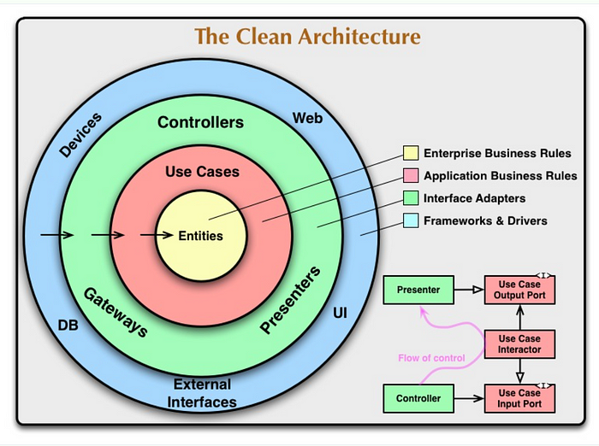
Additional Patterns
Gamma et al. is not the last word on design patterns.
Clean Arch/Hex pattern is a common one in my world of Web applications.
A search of the web will turn up more. I found 20 on concurrency alone.

Slide 43

Summary
Read and understand you code before deciding what to do with it.
To do pattern refactoring, you have to know what the patterns are.
When refactoring with patterns, you can go towards the pattern, with out going all the way.
Practice, practice, practice.

Slide 44

Bibliography
Design Patterns: Elements of Reusable Object-Oriented Software, Erich Gamma, et al (1994)
Refactoring: Improving the Design of Existing Code, Martin Fowler, Kent Beck (1999, 2018)
Refactoring to Patterns, Joshua Kerievsky (2004)
Working Effectively with Legacy Code, Michael Feathers, (2004)
Clean Code: A Handbook of Software Agile Craftsmanship, Robert Martin, (2008)
https://en.wikipedia.org/wiki/Software_design_pattern
Slides:
https://tinyurl.com/2wrry7hk

Slide 45
Thank You
Aaron McClennen, aaron_mcclennen@yahoo.com
M. Jeff Wilson, @mjeffw

